Slide 1


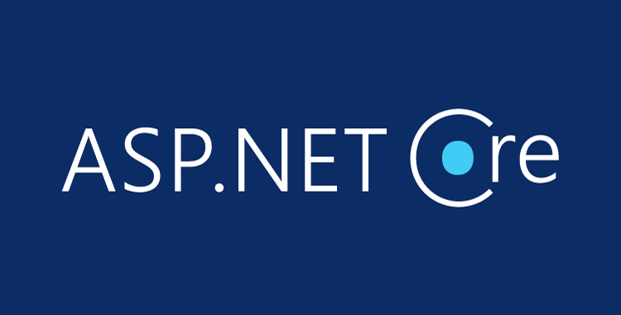

ASP.NET Core Introduction
Environment Setup, First Look, Components, Architecture
C# MVC Frameworks
SoftUni Team
Technical Trainers
Software University
http://softuni.bg

Slide 2
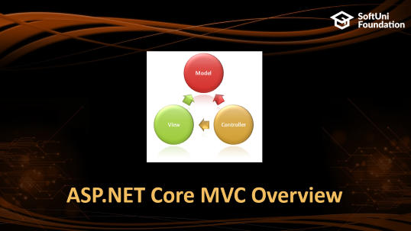
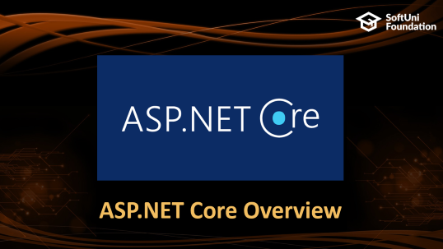
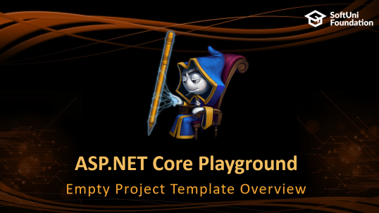

Table of Contents

Slide 3
Questions
sli.do #csharp-web

Slide 4
ASP.NET Core Overview

Slide 5
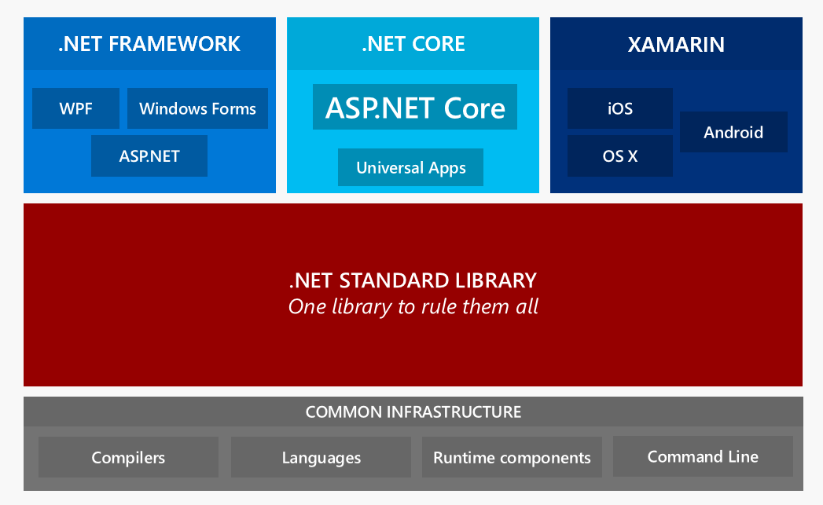
.NET Core: Bird's Eye View

Slide 6
ASP.NET Core Overview
ASP.NET Core is a cross-platform, open-source framework
You can build web applications and services, IoT apps, and mobile backends with ASP.NET Core.
ASP.NET Core provides:
Integration of modern client-side frameworks and development workflows
ASP.NET Core applications run both on .NET Core and .NET Framework

Slide 7
ASP.NET vs ASP.NET Core
ASP.NET is a mature framework (v1.0 released January 2002)
Provides the services needed to build enterprise-class, server-based web applications on Windows.
ASP.NET Core is a relatively new open-source framework (v1.0 released June 2016)
Cross-platform framework
Suitable for building modern, cloud-based web applications on Windows, macOS, or Linux
Latest version: 2.1 (2.1.0 – 30 May 2018)

Slide 8
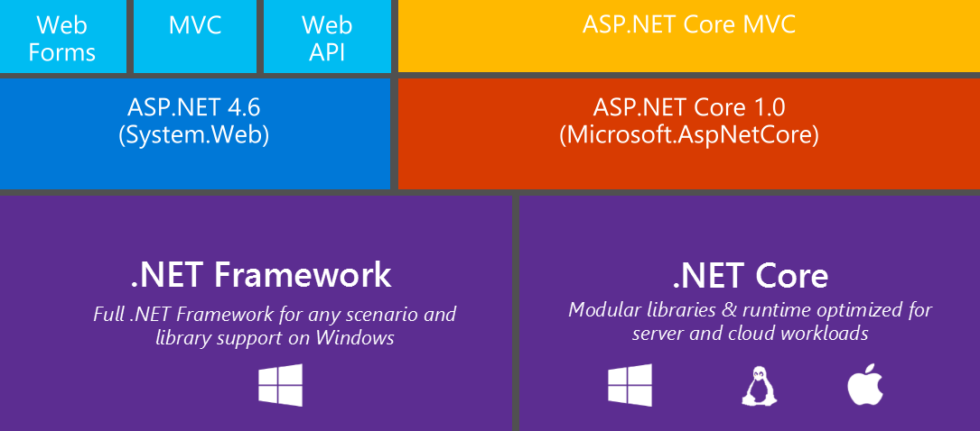
ASP.NET Development Stack Overview

Slide 9
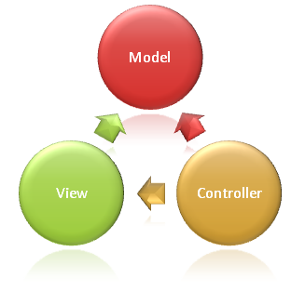
ASP.NET Core MVC Overview

Slide 10
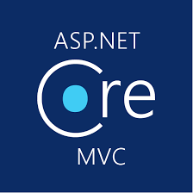
ASP.NET Core MVC
ASP.NET Core MVC is a rich framework for building web apps and APIs
Uses the Model-View-Controller design pattern
Lightweight, Open Source & Highly Testable
Optimized for use with ASP.NET Core
Provides patterns-based ways to build dynamic websites

Slide 11
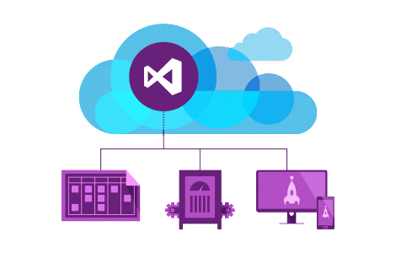
ASP.NET Core MVC
ASP.NET Core MVC makes it easy to:
Create SEO-friendly URLs
Create Single Page applications
Achieve Separation of Concerns
Adopt REST concepts
Implement Test Driven Development
Achieve high-quality architecture design, optimizing developer work (Convention over Configuration)

Slide 12
ASP.NET Core MVC
ASP.NET Core MVC provides cool features like:
Razor View Engine
One of the greatest view engines
With IntelliSense, integrated in Visual Studio
Support for building Web APIs
Building services that can reach a broad range of clients
Support for cross-origin resource sharing (CORS)

Slide 13


ASP.NET Core MVC
Along with those ASP.NET Core MVC provides features like:
Routing
Model binding & model validation
Dependency injection
Strongly-typed views & view components
Tag helpers
And many more…

Slide 14

Setting up the SDK
Installation and Configuration

Slide 15
Setting up the SDK
Install the .NET Core SDK
https://www.microsoft.com/net/learn/get-started/windows
Check installation: open a console and type dotnet
Trust development HTTPS certificates
Create and run an app from a template
dotnet dev-certs https --trust
dotnet new webApp –o <app name>
cd <app name>
dotnet run

Slide 16
ASP.NET Core Templates
Pages, WebAPI, MVC

Slide 17

Summary
ASP.NET Core is a great platform for developing Web apps
Well-designed
Easily extensible
Highly testable
Runs on .NET Framework and .NET Core
Multi-platform support
Has a large (and growing) community
Built from the ground up
But makes development easier for legacy ASP.NET developers

Slide 18







Introduction to ASP.NET Core
https://softuni.bg/courses/asp-net-mvc

Slide 19
License
This course (slides, examples, demos, videos, homework, etc.) is licensed under the "Creative Commons Attribution-NonCommercial-ShareAlike 4.0 International" license

Slide 20





Trainings @ Software University (SoftUni)
Software University – High-Quality Education, Profession and Job for Software Developers
softuni.bg
Software University Foundation
http://softuni.foundation/
Software University @ Facebook
facebook.com/SoftwareUniversity
Software University Forums
forum.softuni.bg

